Slide 1
Analysis of Power BI Report on E-commerce Sales
-BY ISHIKA GUPTA

Slide 2
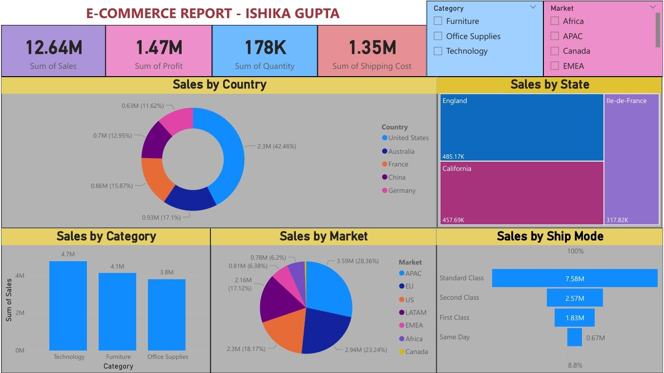
E-commerce Sales Report:

Slide 3
🔍 Key Observations:
Top-Level Metrics:
Total Sales: 12.64M
Total Profit: 1.47M
Total Quantity Sold: 178K
Shipping Cost: 1.35M
Sales by Country:
United States leads with 2.3M (42.46%)
Other countries (Australia, France, China, Germany) contribute significantly less.
Insight:
There's a heavy reliance on the US market. Other regions need scaling for balanced growth.

Slide 4
Continue:
Sales by State:
England: 485.17K
California: 457.69K
Ile-de-France: 317.82K
Insight:
Certain states/regions outperform others. US and UK show strong performance.
Sales by Category:
Technology: 4.7M
Furniture: 4.1M
Office Supplies: 3.8M
Insight:
Technology is the leading category. The gap between categories isn't huge, indicating fairly balanced demand.

Slide 5
Continue:
Sales by Market:
APAC: 3.59M (28.36%)
EMEA: 2.94M (23.24%)
US: 2.3M (18.17%)
Other regions contribute less.
Insight:
APAC and EMEA are strong contributors.
LATAM and Canada are relatively weak.

Slide 6
Thank you

